Slide 1
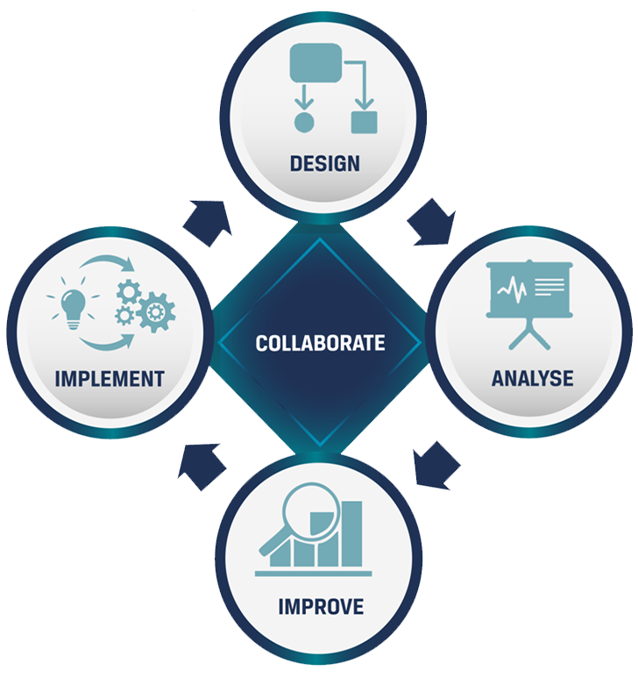
Process Governance Model
CENTRALISED OR DECENTRALISED PROCESS MAPPING TEAM?
Your one stop BPM shop:
PRIME BPM Software
BPM Education
Fixed Cost Process Mapping
BPM Coaching
www.primebpm.com

Slide 2
Trusted By
& many more......

Slide 3
Who Am I?
Mark Khabe
Co–Founder, PRIME BPM
15+ Years of Business Process Management Experience
Strategised and implemented BPM solutions for organisations such as GE, Rolls Royce, Sanofi, Suncorp, Vodafone, AMP, ATO, Pfizer, Coca-Cola, etc.
Passionate about solving complex BPM challenges and helping organisations to do more with less
- https://www.linkedin.com/in/markkhabe/

Slide 4
Agenda
Part 1
What is Process Governance and why we need it
Part 2
Models of Process Governance
Part 3
Assess which model works for you?
Part 4
How to combine the power of both the models?
Part 5
Steps to establish effective governance structure

Slide 5
1
Who is going to map the processes?
What is Process Governance
2
Who is going to approve and implement the process change
3
What standards are going to be followed
It Answers Critical Questions
4
How will the success be measured?
5
How can a continuous improvement cycle be established?
6
How can BPM be embedded into organisational DNA?

Slide 6
WHY WE NEED PROCESS GOVERNANCE?
Lack of Process Governance results in
What is Process Governance
Inconsistent Process Mapping Approach
Unrealised Benefits
Lack of Momentum
Delayed Timelines
Lack of Order
Establishes tight control for BPM Initiatives by defining:
WHO
WHAT
HOW

Slide 7
PROCESS GOVERNANCE MODELS
CENTRALISED GOVERNANCE MODEL
DECENTRALISED GOVERNANCE MODEL

Slide 8
CENTRALISED GOVERNANCE MODEL
1
A central team controls BPM projects and process mapping efforts
2
Team includes dedicated process mapping and improvement analysts
3
Defines common methodology, toolset, process mapping standards for organisation-wide usage

Slide 9
DECENTRALISED GOVERNANCE MODEL
1
Individual business units map, improve and maintain their processes
2
Process champions and SMEs are trained on process mapping and improvement
3
Responsible for ongoing continuous improvement

Slide 10
Is there clarity in your processes and roles and responsibilities?
Which Model Works for You?
Does your organisation have a high level of Process Maturity?
Consider these questions
Does your organisation have a business process library?
Are the right standards in place to ensure consistent documentation?
Are you using the common toolset and methodology across the organisation?

Slide 11
The Best Fit for You
If your answers are mostly YES
You have already achieved a certain level of maturity
Common toolset, methodology and standards are in place
Choose a Decentralised Process Mapping Team
If your answers are mostly Nos
You have just started (or are considering starting) your process improvement efforts
Need to ensure the initial momentum is not lost
Choose a Centralised Process Mapping Team

Slide 12
Combining the Power of Both
With Centralised Team Ensure:
Tight control on the initiative and its objectives
Standardised tool set and methodology
Sustained momentum with a core focus area
After 6-12 months you will have:
A Central repository of high priority processes
Common standards and tools defined
Transition to a Decentralised Model
Make process improvement a BAU
Avoid additional cost in building a separate team

Slide 13
8 Steps
WHY WE NEED PROCESS GOVERNANCE?
1. Choose the Right Pilot Project
2. Execute and Showcase the Pilot
3. Develop and ensure the right skill set
Establishes tight control for BPM Initiatives by defining:
To Transition from Centralised to Decentralised Model
6. Build the Larger Central Team
5. Get The Right Toolset
4. Set the Right Standard
WHO
WHAT
HOW
7. Build the Enterprise Process Library
8. Move to the Decentralised Model

Slide 14
1. Choose the Right Pilot Project
1. Choose the Right Pilot Project
Pilot Project Objectives
Identify, assess and fix any issues before a full rollout
Showcase the results and achievements
Look for a Process that is:
High-Volume
High-Frequency
Manual Intensive
Multiple Handover points

Slide 15
2. Execute and Showcase the Pilot
Execute the Pilot and Highlight Project Achievements and Results
Business Leaders should see BPM Implementation:
Value
ROI
Business Impact

Slide 16
Build/ Ensure Team Capabilities for Skills in:
Process Mapping
Process Analysis
Process Improvement
Process Implementation
Change Management
3. Develop / Ensure the Right Skill Set

Slide 17
Choose standard mapping notations, such as BPMN
Consistent documentation
Accurate, easy to read process maps
Supports future projects
Proves useful in Digital Transformation Initiatives
4. Set the right standards

Slide 18
5. Get the Right Toolset
Key Functionalities
Built-in methodology
Facilitates End-to-end improvement from documentation to collaboration
Embedded with worldwide accepted standards
Built-in Quality Management Principles, such as Six Sigma
Points to remember
There is no one-size fits-all tool
Assess organisational requirement with tool capabilities

Slide 19
6. Recruit a Larger Central Team
Appoint a Larger Team to build an Enterprise Process Library
Train the members on defined
Templates
Methodology
Toolsets

Slide 20
7. Start building an Enterprise Process Library
Identify
High Volume
High Frequency
High Priority
High Customer Touch
High Risk Processes
Create a Central Repository of Processes in 6-12 months

Slide 21
8. Move to the Decentralised Model
Once a central repository of high priority processes is ready:
Individual business units can carry on the Continuous Improvement Journey
Process Improvement can become an organisational BAU

Slide 22
Process Governance is a must to prevent isolated and disconnected BPM efforts.
A Quick Recap
Start by assessing your organisation’s process maturity level to decide the right governance model
If already achieved a certain level of process maturity, choose a decentralised model
If just started or starting process improvement efforts, begin with a centralised model
Follow a step-by-step approach to transition from centralised to decentralised model for combined benefits

Slide 23
THANK YOU!

